Slide 1
UNIT - 2

Slide 2
Tokens
Smallest unit in a C++ program that the compiler understands.
Types of Tokens:
1) Keywords
2) Identifiers
3) Constants
4) Punctuators
5) Operators

Slide 3
Keywords
Keywords are reserved words that carry predefined meanings and specific functionalities within a program.
The total number of keywords in C++ are 95.
Examples of common keywords:
→ int, float, if, else, for, while, class, public, private, return, try, catch, virtual, namespace, etc.

Slide 4
Keywords
if | else | switch | case | default
break | continue | goto | return | for
while | do | auto | register | static
extern | short | int | long | signed
unsigned | float | double | void | bool
char | const | class | struct | union
enum | typedef | using | namespace | new
delete | sizeof | inline | friend | virtual
true | false | nullptr

Slide 5
Identifiers
Identifiers are the unique names assigned to variables, functions, classes, structs, or other entities within the program.
Example:
int num = 10;
string first_name = “Ram”;

Slide 6
Rules to define the name of identifier:
An identifier can only begin with a letter or an underscore(_).
An identifier can consist of letters (A-Z or a-z), digits (0-9), and underscores (_). White spaces and Special characters can not be used as the name of an identifier.
Keywords cannot be used as an identifier because they are reserved words to do specific tasks. For example, string, int, class, struct, etc.
Identifier must be unique in its namespace. As C++ is a case-sensitive language so identifiers such as 'first_name' and 'First_name' are different entities.

Slide 7
Valid Names
Invalid Names
1) 12raju //Starts with digit
2) mohan sharma //contains space
3) int, float, string // keywords
_ram ,
ram_shyam ,
ram23 ,
shyam_001

Slide 8
Constants
Constants are fixed values in a program whose value cannot be changed during execution.
Type | Syntax / Example | Explanation
Literal Constants | int x = 10; char ch = 'A'; | Fixed values written directly in code.
const Keyword | const float pi = 3.14; | Declares a variable as constant → cannot be modified.
#define Macro | #define MAX 100 int arr[MAX]; | Preprocessor constant (symbolic name for a value).
Enumerated Constants | enum Colors { RED, GREEN, BLUE }; | Defines a group of named integer constants.

Slide 9
Punctuators
Punctuators are the token characters having specific meanings within the syntax of the programming language. These symbols are used in a variety of functions, including ending the statements, defining control statements, separating items, and more.
Punctuators in C++ are:
1) Semicolon (;): It is used to terminate the statement.
2) Square brackets []: They are used to store array elements.
3) Curly Braces {}: They are used to define blocks of code.
4) Double-quote ("): It is used to enclose string literals.
5) Single-quote ('): It is used to enclose character literals.

Slide 10
Operators
C++ operators are special symbols that are used to perform operations on operands such as variables, constants, or expressions.
Types of Operators:
1) Arithmetic: +, -, *, %, /
2) Relational: ==, !=, <, >
3) Logical: &&, ||, !
4) Assignment: =, +=, -=
5) Bitwise: &, |, ^, <<, >>

Slide 11
Variables
Variable is a name given to a memory location. It is the basic unit of storage in a program. The value stored in a variable can be accessed or changed during program execution.
Syntax of variable definition:
--> type name;
where, type is the type of data that a variable can store, and name is the name assigned to the variable
Example: int value; //Declaration of variable
value = 5; // Intializing a variable
int a = 10; // Declaration and Intialization

Slide 12
Variable Naming Convention
The set of rules for naming a variable are same as identifier. These are suggestions for naming variables for easier understanding.
Start with lowercase alphabet.
Use camelCase (first letter of word should be lowercase and then each word begin with uppercase. Eg:(studentName, firstName)
Constants usually in UPPERCASE → MAX_VALUE, MIN_VALUE
Use descriptive, meaningful names.
For example, first_name, frequencyCount.

Slide 13
Scope of Variable
When you declare a program element such as a class, function, or variable, its name can only be "seen" and used in certain parts of your program. The context in which a name is visible is called its scope.
Types of Variable Scope:
Local Scope
Global Scope

Slide 14
Local Scope
Variables defined within a function or block are said to be local to those functions or a block and are called local variables. Local variables do not exist outside the block in which they are declared, i.e. they cannot be accessed or used outside that block.
#include <iostream>
int main() {
{
int x = 10; // Local variable, Scope local to only this block
cout << x; // Works here
}
cout << x; // Error: x not visible here
}

Slide 15
Global Scope
Global scope refers to the region outside any function or a block. The variables declared here are accessible throughout the entire program and are called Global Variables.
#include <iostream>
int x = 20; // Global variable
int main() {
cout << x; // Accessible everywhere
}

Slide 16
Scope and Lifetime of Variables
Scope | Lifetime | Example
Local Scope | Exists only within the block/function | void func(){ int x=5; }
Global Scope | Exists throughout program execution | int x=10; int main(){}

Slide 17
Data Types in C++
Primitive
Derived
User Defined
int
Array
Class
float
function
Structure
double
char
pointer
Union
boolean
Enum

Slide 18
Data Type | Keyword | Example | Size (approx.) | Range
Boolean | bool | bool pass = true; | 1 byte | true / false
Character | char | char grade = 'A'; | 1 byte | -128 to 127 (signed)0 to 255 (unsigned)
Short Integer | short | short age = 25; | 2 bytes | -32,768 to 32,767
Integer | int | int marks = 90; | 4 bytes | -2,147,483,648 to 2,147,483,647
Long Integer | long | long population = 100000; | 4 or 8 bytes | (4B) -2,147,483,648 to 2,147,483,647(8B) -9,223,372,036,854,775,808 to 9,223,372,036,854,775,807

Slide 19
Data Type | Keyword | Example | Size (approx.) | Range
Long Long Int | long long | long long stars = 1000000000; | 8 bytes | -9,223,372,036,854,775,808 to 9,223,372,036,854,775,807
Float | float | float pi = 3.14; | 4 bytes | ~1.2E−38 to 3.4E+38
Double | double | double g = 9.81; | 8 bytes | ~2.3E−308 to 1.7E+308
Long Double | long double | long double val = 3.14159; | 8–16 bytes | ~3.4E−4932 to 1.1E+4932
String | string | string name = "Apporva"; | Depends | Depends on length

Slide 20

Operators
Operators are special symbols that are used to perform operations on operands
such as variables, constants, or expressions.
For example: (A+B), in which 'A' and 'B' are operands, and '+' is an arithmetic operator
which is used to add two operands.

Slide 21





UNARY
OPERATOR
BINARY
OPERATOR
BASED ON NO. OF OPERANDS
TERNARY
ARITHMETIC
OPERATORS
OPERATOR
RELATIONAL
OPERATORS
CLASSIFICATION OF OPERATORS
LOGICAL
OPERATORS
BASED ON ROLE OF OPERATOR
BITWISE
OPERATORS
ASSIGNMENT OPERATORS
MISCELLANEOUS OPERATORS

Slide 22
Unary Operators
Unary operator operates on only one operand.
For example, in the expression -3,
The operand can be present towards the right of unary operator, as in -3 or towards the left of unary operator, as in the expression a++.
Examples of unary operators are:
1. & (address-of operator)
2. sizeof operator
3. ! (logical negation)
4. ~ (bitwise negation)
5. ++ (increment operator)
6. -- (decrement operator) etc.

Slide 23
Binary Operators
Binary operator operates on two operands. It requires an operand towards its left and right.
For example, in expression 2-3
Examples of binary operators are:
1. * (multiplication operator),
2. / (division operator),
3. << (left shift operator),
4. == (equality operator),
5. && (logical AND),
6. & (bitwise AND) etc.

Slide 24
Ternary Operators
Ternary operator operates on three operands.
Conditional operator (i.e. ?:) is the only ternary operator available in Cpp.
Expression1 ? Expression2 : Expression3;
If Expression1 became true then Expression2 will be executed otherwise Expression3 will be executed.

Slide 25
Operator Precedence
Each operator in Cpp has a precedence associated with it.
In a compound expression, if the operators involved are of different precedence, the operator of higher precedence is evaluated first. For example, in an expression b=2+3*5, The precedence order is * > + > = .
To determine which of these operators will operate first, the associativity of these operators is to be considered.

Slide 26
Associativity of Operators
An operator can be either left-to-right associative or right-to-left associative.
If operators are left-to-right associative, they are applied in left-to-right order i.e. the operator which appears towards left will be evaluated first.
If they are right-to-left associative, they will be applied in the right-to-left order.
The multiplication and the division operators are left-to- right associative.
Hence, in expression 2*3/5, * evaluated first then / from left to right.

Slide 27
Arithmetic Operators
The arithmetic operations like addition, subtraction, multiplication, division etc. can be performed by using arithmetic operators.
S.No | Operator | Name of Operator | Category | ary of Operators | Precedence | Associativiy
1. | + - ++ -- | Unary plus Unary minus Increment Decrement | Unary operators | Unary | Level-I (Highest) | R→L (Right-to- left)
2. | * / % | Multiplication Division Modulus | Multiplicative operators | Binary | Level-II (Intermediate) | L→R (Left-to- right)
3. | + - | Addition Subtraction | Additive operators | Binary | Level-III (Lowest) | L→R

Slide 28
Relational Operators
Relational operators are used to compare two quantities (i.e. their operands).
S.No | Operator | Name of Operator | Category | ary of Operators | Precedence amongst relational class | Associativity
1. | < > <= >= | Less than Greater than Less than or equal to Greater than or equal to | Relational operators | Binary | Level-I | L→R
2. | == != | Equal to Not equal to | Equality operators | Binary | Level-II | L→R

Slide 29
Logical Operators
Logical operators are used to logically relate the expressions.
S.No | Operator | Name of Operator | Category | ary of Operator s | Precede nce amongst logical class | Associati vity
1. | ! | Logical NOT | Unary | Unary | Level-I | R→L
2. | && | Logical AND | Logical operator | Binary | Level-II | L→R
3. | || | Logical OR | Logical operator | Binary | Level-III | L→R

Slide 30
Bitwise Operators
These operators do not consider operand as one entity and operate on the individual bits of operands.
S.No | Operator | Name of Operator | Category | ary of Operators | Precedence amongst bitwise class | Associativity
1. | ~ | Bitwise NOT | Unary | Unary | Level-I | R→L
2. | << >> | Left Shift Right Shift | Shift operators | Binary | Level-II | L→R
3. | & | Bitwise AND | Bitwise operator | Binary | Level-III | L→R
4. | ^ | Bitwise X-OR | Bitwise operator | Binary | Level-IV | L→R
5. | | | Bitwise OR | Bitwise operator | Binary | Level-V | L→R

Slide 31
Assignment Operators
A variable can be assigned a value by using assignment operator.
S.No | Operator | Name of Operator | Category | ary of Operators | Precedence | Associativity
1. | = *= /= %= += -= &= |= ^= <<= >>= | Simple assignment Assign product Assign quotient Assign modulus Assign sum Assign differenceAssign bitwise AND Assign bitwise OR Assign bitwise XOR Assign left shift Assign right shift | Assignment Shorthand assignment operators | Binary | Level-I | R→L

Slide 32
Conditional Operator
Conditional operator is the only ternary operator available in Cpp.
The general form of conditional operator is E1?E2:E3, where E1, E2 and E3 are sub-expressions.
The sub-expression E1 must be of scalar type .
The sub-expression E1 is evaluated first. If it evaluates to a non-zero value (i.e. true), then E2 is evaluated and E3 is ignored.
If E1 evaluates to zero (i.e. false), then E3 is evaluated and E2 is ignored.

Slide 33
Miscellaneous Operator
Other operators available in Cpp are:
Function call operator (i.e. ())
Array subscript operator (i.e. [])
Member select operator
Direct member access operator (i.e. . (dot operator or
period))
Indirect member access operator (i.e. -> (arrow operator))
Indirection operator (i.e. *)
Conditional operator (i.e. ?:)
Comma operator (i.e. ,)
sizeof operator
Address-of operator (i.e. &)

Slide 34
Sizeof Operator
The sizeof operator is used to determine the size in bytes that a value or a data object will take in memory.
The general form of sizeof operator is:
sizeof expression or sizeof (expression)
For example: sizeof 2, sizeof(a), sizeof(2+3)
sizeof(type-name) For example: sizeof(int), sizeof(int*), sizeof(char)
The type of result of evaluation of sizeof operator is int.

Slide 35
Address-of Operator
The address-of operator is used to find address i.e. l-value of a data object.
The following are the important points about address-of operator:
1. The address-of operator must appear towards the left side of its operand.
2. The syntax of using address-of operator is & operand.

Slide 36
COMBINED PRECEDENCE OF ALL OPERATOR
S.N o | Operator | Name of Operator | Category | ary of Operator s | Precedence | Associativity
1. | () [] -> . | Function call Array subscript Indirect member access Direct member access |  |  | Level-I (Highest)
2. | ! ~ + - ++ -- & * sizeof | Logical NOT Bitwise NOT Unary plus Unary minus Increment Decrement Address-of Indirection Sizeof | Unary | Unary | Level-II | R→L
3. | * / % | Multiplication Division Modulus | Multiplicative operators | Binary | Level-III | L→R

Slide 37
S.No | Operator | Name of Operator | Category | ary of Operators | Precedence | Associativity
4. | + - | Addition Subtraction | Additive operators | Binary | Level-IV | L→R
5. | << >> | Left Shift Right Shift | Shift operators | Binary | Level-V | L→R
6. | < > <= >= | Less than Greater than Less than or equal to Greater than or equal to | Relational operators | Binary | Level-VI | L→R
7. | == != | Equal to Not equal to | Equality operators | Binary | Level-VII | L→R
8. | & | Bitwise AND | Bitwise operator | Binary | Level-VIII | L→R
9. | ^ | Bitwise X-OR | Bitwise operator | Binary | Level-IX | L→R
10. | | | Bitwise OR | Bitwise operator | Binary | Level-X | L→R
11. | && | Logical AND | Logical operator | Binary | Level-XI | L→R
12. | || | Logical OR | Logical operator | Binary | Level-XII | L→R
13. | ?: | Conditional operator | Conditional | Ternary | Level-XIII | R→L

Slide 38
S.No | Operator | Name of Operator | Category | ary of Operator s | Precedence | Associativity
14. | = *= /= %= += -= &= |= ^= <<= >>= | Simple assignment Assign product Assign quotient Assign modulus Assign sum Assign Difference Assign bitwise AND Assign bitwise OR Assign bitwise XOR Assign left shift Assign right shift Assign | Assignment & Shorthand assignment operators | Binary | Level-XIV | R→L
15. | , | Comma operator | Comma | Binary | Level-XV (Least) | L→R

Slide 39
Usage of Math Library
Header: #include<cmath>
Namespace: std
Provides mathematical functions for operations in Cpp.
Constants (C++20 in ):
- std::numbers::pi = 3.141592653589793...
- std::numbers::e = 2.718281828459045…
Type Variants:
- float → sinf, cosf, powf
- long double → sinl, cosl, powl

Slide 40
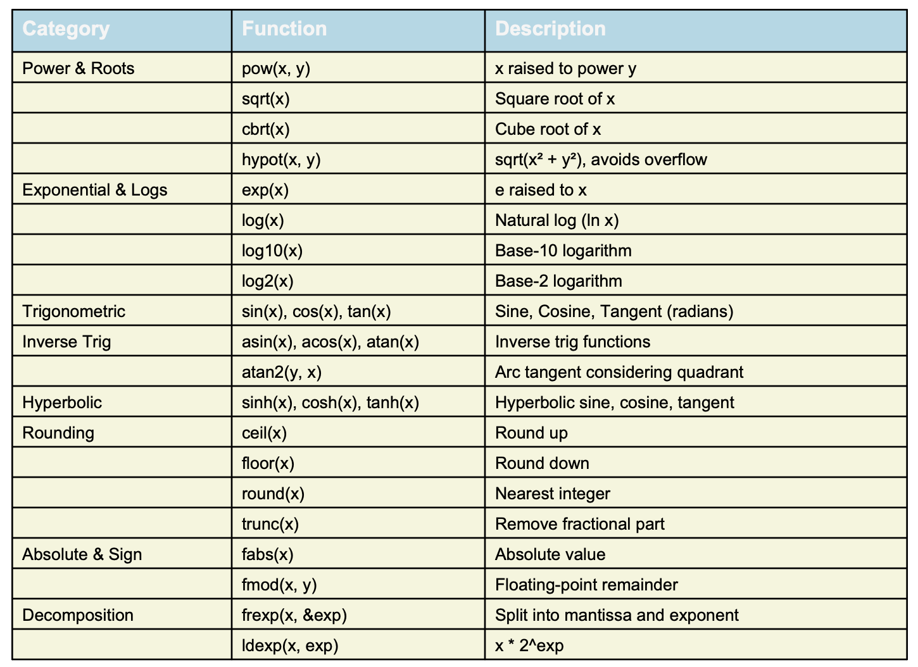
Usage of math library function

Slide 41
Usage of math library function
Example Code:
#include<cmath>
#include using namespace std;
int main()
{
double x = 9.0;
cout << "Square root: " << sqrt(x) << endl;
cout << "Power: " << pow(2, 3) << endl;
return 0;
}

Slide 42
Typecasting
Typecasting in C++ is the process of converting one data type into another. It allows us to perform operations between incompatible data types by explicitly or implicitly converting them.
Implicit Typecasting:
→ Done automatically by the compiler.
→ Converts smaller data type → larger data type
→ Example: int x = 10;
double y = x;
Explicit Typecasting:
→ Done manually by the programmer.
→ Example: double pi = 3.14159;
int value = (int) pi;

Slide 43
Taking Inputs on Coding Platforms
Single value in a single line:
#include <iostream>
int main() {
int n;
cin >> n; // Input: 5
cout << "You entered: " << n;
return 0;
}

Slide 44
Taking Inputs on Coding Platforms
Multiple known values in a single line:
#include <iostream>
int main() {
int a, b, c;
cin >> a >> b >> c; // Input: 10 20 30
cout << "Sum = " << a + b + c;
return 0;
}

Slide 45
Taking Inputs on Coding Platforms
Multiple known values in multiple lines.
#include <iostream>
int main() {
int x, y;
cin >> x; // Input: 7
cin >> y; // Input: 8
cout << "Product = " << x * y;
return 0;
}

Slide 46

Program Flow Control

Slide 47
Conditional Statements
Conditional statements help you to make a decision based on certain conditions. These conditions are specified by an expression which are evaluated to a boolean value of true or false.
C++ has the following conditional statements:
if
else
else if
switch

Slide 48
‘If’ Statement
To specify a block of code to be executed, if a specified condition is true.
The general form of if statement is:
if(expression)
statement
//←if header
//←if body

Slide 49
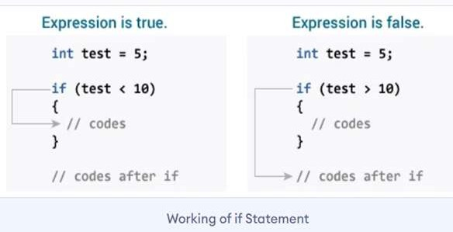
‘If’ Statement (Cont..)

Slide 50
‘If Else’ Statement
Most of the problems require one set of actions to be performed if a particular condition is true and another set of actions to be performed, if the condition is false.
To implement such a decision, C++ language provides if-else
statement.
The general form of if-else statement is:
if(expression) statement1
else
statement2
//←if-else header
//←if body
//←else clause
//←else body

Slide 51
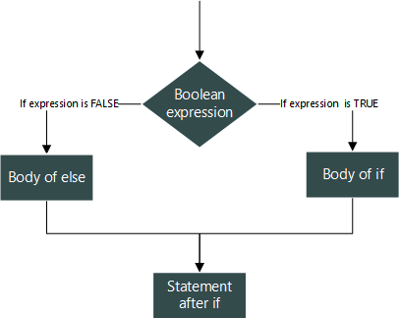
Flow chart of if else statement

Slide 52
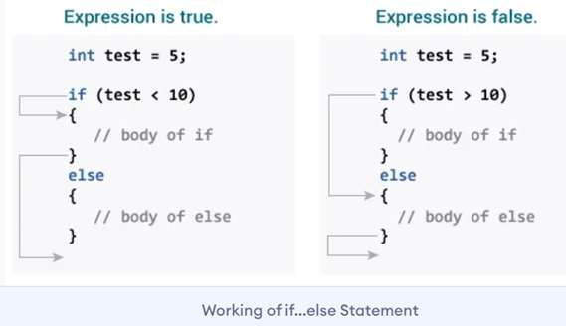
‘If Else’ Statement (cont…)

Slide 53
Program to input a number and display the same if it is positive or negative.
#include <iostream>
using namespace std;
int main() {
int num;
cout << "Enter a number: ";
cin >> num;
if (num > 0) {
cout << "Number " << num << " is positive." << endl;
}
else {
cout << "Number " << num << " is negative." << endl;
}
return 0;
}
OUTPUT –
Enter a number: -9
Number -9 is negative.

Slide 54
‘Nested If Else’ Statement
If the body of if statement is another if statement
if( expression1 ){
if( expression2 ){ statement-block1;
}
else {
statement-block 2;
}
}
else
{
if( expression3 ){
statement-block3;
}
else {
statement-block 4;} }
if( expression1 )
{
if( expression2 )
{
statement-block1;
}
else
{
statement-block 2;
}
}
else
{
statement-block 3;
}

Slide 55
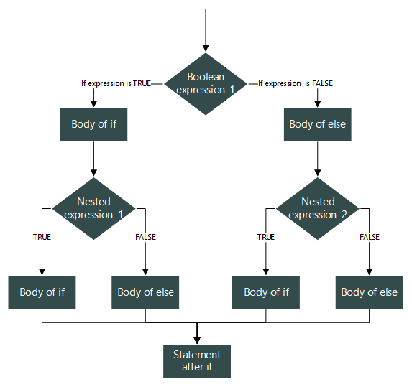
Flow chart of nested if else statement

Slide 56
‘If Else Ladder’
if (test expression1) {
// statement(s)
}
else if(test expression2) {
// statement(s)
}
else if (test expression3) {
// statement(s)
}
else {
// statement(s)
}

Slide 57
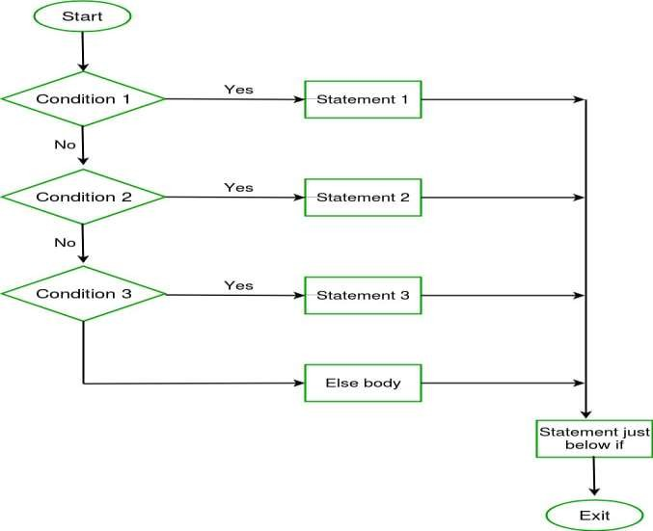
Flow chart of if else ladder statement

Slide 58
Switch Statement
switch(expression)
{
case value_1:
/* Statement/s */
break;
case value_2:
/* Statement/s */
break;
case value_n:
/* Statement/s */
break;
default:
/* Statement/s */
}
The switch statement is used to control complex branching operations.
When there are many conditions, it becomes too difficult and complicated to use if and if-else constructs.

Slide 59
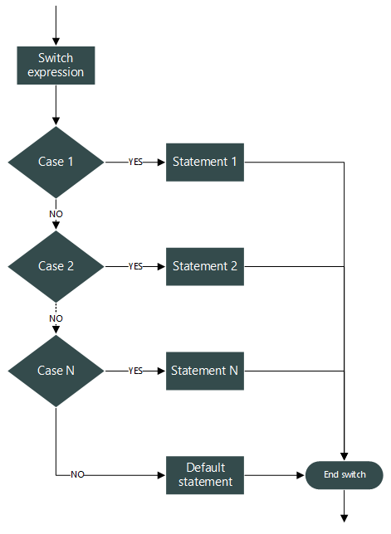
Flow chart of Switch statement

Slide 60

C++ program to print name of the day of week.
#include <iostream>
using namespace std;
int main() {
int day;
cout << "Enter a number (1-7): ";
cin >> day;
switch (day) {
case 1: cout << "Sunday"; break;
case 2: cout << "Monday"; break;
case 3: cout << "Tuesday"; break;
case 4: cout << "Wednesday"; break;
case 5: cout << "Thursday"; break;
case 6: cout << "Friday"; break;
case 7: cout << "Saturday"; break;
default: cout << "Invalid input! Please enter number between 1 and 7.";
}
return 0;
}

Slide 61
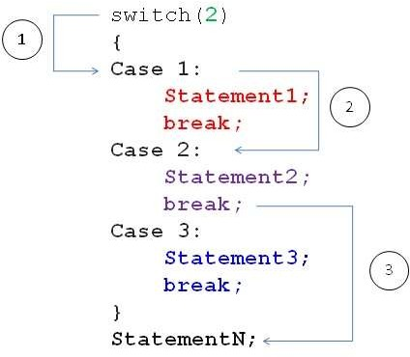
How break statement works?

Slide 62


C++ PROGRAM TO CHECK VOWEL OR CONSONANT USING SWITCH CASE (break statement using in each case)
#include <iostream>
using namespace std;
int main() {
char ch;
cout << "Enter any alphabet: ";
cin >> ch;
switch(ch) {
case 'a': cout << "Vowel"; break;
case 'e': cout << "Vowel"; break;
case 'i': cout << "Vowel"; break;
case 'o': cout << "Vowel"; break;
case 'u': cout << "Vowel"; break;
case 'A': cout << "Vowel"; break;
case 'E': cout << "Vowel"; break;
case 'I': cout << "Vowel"; break;
case 'O': cout << "Vowel"; break;
case 'U': cout << "Vowel"; break;
default: cout << "Consonant";
}
return 0;
}

Slide 63
Switch Vs Else-If Ladder
S. No. | Switch | Else-If Ladder
1 | It executes the different cases on the basis of the value of the switch variable. | It executes the different blocks based on the condition specified.
2 | It can only evaluate the int or char type expressions. | It can evaluate any type of expression.
3 | Faster and easier to read for the large number of conditions. | It can get messy when there are lots of conditions.

Slide 64
Reference
Geeksforgeeks https://www.geeksforgeeks.org/cpp/c-c-if-else-statement-with-examples/
W3Schools https://www.w3schools.com/cpp/cpp_conditions.asp
Tutorialspoint.com https://www.tutorialspoint.com/cplusplus/cpp_conditional_operator.htm

